Slide 1
CSSE 332 Page Replacement
Thursday, April 30, 2020

Slide 2
Questions
How does the operating system provide the illusion of infinite virtual memory?
Swapping Policies: How OS choose what page to replace when page fault occurs?
Swapping issues
thrashing
(Optional) Memory management: Copy-on-Write http://pages.cs.wisc.edu/~remzi/OSTEP/vm-beyondphys-policy.pdf

Slide 3
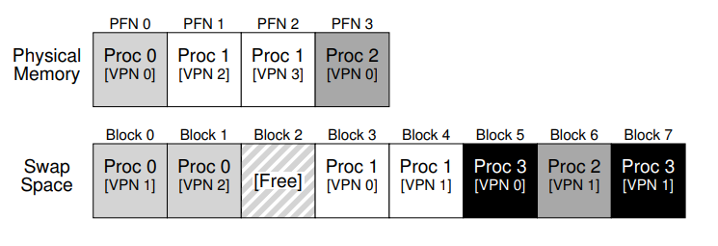
Swapping: Swap Space
The swap space is a portion of disk reserved for moving pages back and forth:
Used to hold pages of currently running processes
Present bit in PTE tracks whether page is in physical memory or not

Slide 4
Swapping: Page Fault
If a page is not present in physical memory, then the hardware triggers a page fault that the operating system handles.
If page is not present and has been swapped to disk, then OS looks up location in PTE and loads it from swap space
If there are no free page frames in physical memory, then we need to evict one so we can replace it

Slide 5
Swapping policy: Optimal
Ideally, we would minimize the amount of misses, and thus want to evict pages that will be accessed the furthest in the future.
Unfortunately, this is difficult to determine, so we consider different replacement policies:
FIFO: Pretty poor since it doesn't consider importance of page
We need to track the time of each page was swapped in.
Random: Sometimes really good, sometimes really bad, mostly meh

Slide 6
Optimal Example
Assume the main memory has three frames, a program accesses the following stream of virtual pages: 0, 1, 2, 0, 1, 3, 0, 3, 1, 2, 1
Calculate the page hit rate (i.e., # of hits/total access)
Try FIFO by yourself

Slide 7
Swapping: Least Recent Use
In LRU, we keep track of the history of page accesses and use that information to inform our selection:
With LRU, we evict the least recently used page
To determine the least recently used page, we must update some sort of data structure or time field whenever a page is accessed (so on every memory reference)
This is expensive, so we need a way to approximate it...

Slide 8
LRU Example
Assume the main memory has three frames, a program accesses the following stream of virtual pages: 0, 1, 2, 0, 1, 3, 0, 3, 1, 2, 1

Slide 9
Swapping: Clock
Clock policy:
Every frame has a reference bit (R) that is set to 1 when a page is first loaded in it
R is set to 1 every time the page is referenced
Put pages on a circular buffer in the form of a clock with a “hand” (pointer) referencing the “next” page
Next page: the page after the one that was just replaced in the circular buffer
When page fault occurs,
if “next” page has R = 0 then replace
otherwise set R = o and advance the next page pointer.
Keep advancing until locate page with R = 0.

Slide 10
Clock Example
Assume the main memory has three frames, a program accesses the following stream of virtual pages: 0, 1, 2, 0, 1, 3, 0, 3, 1, 2, 1

Slide 11
Swapping: Thrashing
Suppose the amount of memory requested by running processes exceeds the available physical memory…
Evict page
Page in
Evict page This condition of constantly
Page in swapping is called thrashing.
Evict page
...

Slide 12
Advanced Memory Management Copy-on-Write
Recall: What happens on memory when fork() is called.
Parent’s memory is duplicated to create the child.
Problem: Once there is a fork(), we have to copy the entire memory space of parent to another space.
Solution: Share the same space between parent and child. And only copy when there is a write operation.

